Slide 1
Using T4Eclipse tool to Analyze Eclipse UI
For t4eclipse version 1.2.1
Ben Xu (xufengbing@gmail.com)
July 17,2010

Slide 2

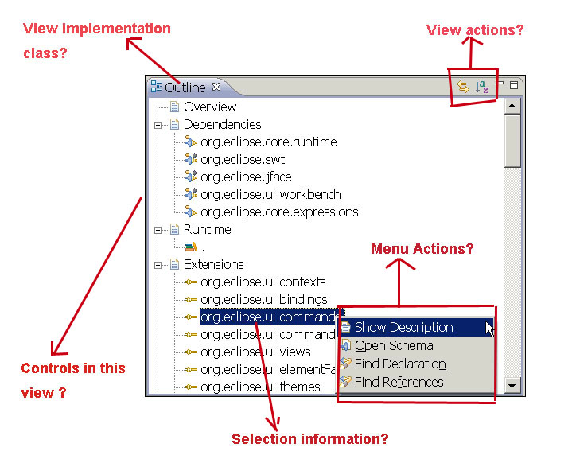
How to get the following answers quickly?

Slide 3
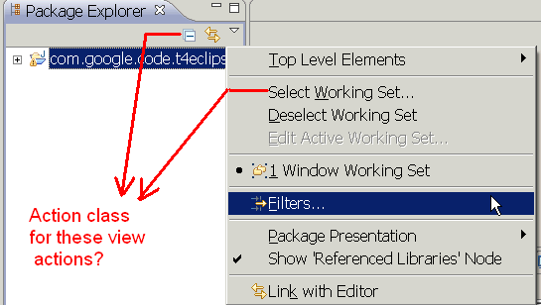
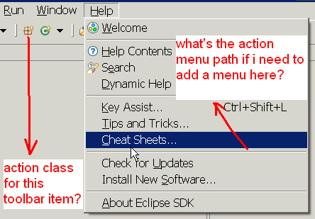
How to get the following answers quickly?

Slide 4
Get what you need in seconds!
The “Alt+Shift+F1” is just not enough!
  Eclipse “Plug-in spy tool” since eclipse 3.4 can provide some information for you. But too limited and depends on eclipse PDE feature
  T4Eclipse tool provide all above functions to find implementation for view/editor/perspective/menu action/toolbar action/ control tree / main menu path/….
  T4Eclipse is created to analyze any eclipse plug-in/RCP application …
  And it’s easy , small and free to use !
T4Eclipse answers all above questions in seconds!

Slide 5
About T4Eclipe
Project home
  http://code.google.com/p/t4eclipse/
@eclipse market place
  http://marketplace.eclipse.org/content/tool-eclipse-t4eclipse
Update site
  http://t4eclipse.googlecode.com/svn/update_site/

Slide 6
About T4Eclipe
What is t4eclipse
  T4Eclipse is an eclipse plug-in tool to analyze eclipse UI, especially to find the underline related java implementation class for different eclipse UI element.
Who need to use t4eclipse
  T4Eclipse is only for eclipse plug-in developers, just as myself
When to use t4eclipse
  You can relay on t4eclipse when you try to locate java source code for
  Eclipse UI such as view/editor/wizard/preference/menu action/…
How to use t4eclipse
  Install t4eclipse to the any eclipse based application (common eclipse or any RCP application)
  Use t4eclipse tool for your use case

Slide 7
T4Eclipse User Guide ----- Install
Install from update site (Recommended Way)
  http://t4eclipse.googlecode.com/svn/update_site/
Install by copy plug-in
  Copy t4eclipse plug-in into related directory for eclipse/RCP applications
    For eclipse 3.3 and previous version, copy to plugins dir
    For eclipse 3.4+ , copy to dropins dir
    Download plug-in from http://code.google.com/p/t4eclipse/
Note
  T4Eclipse tool only depends on “org.eclipse.core.runtime” and “org.eclipse.ui ” plug-ins, which means it can be installed into almost all eclipse based application
  T4Eclipse support all eclipse 3.3.x to latest 3.6 version

Slide 8
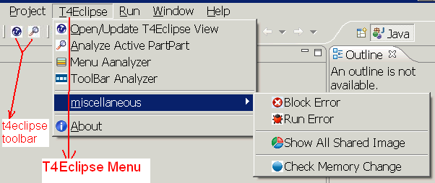
T4Eclipse User Guide ----- T4Eclipse menu/toolbar
After installed successfully, you will see the following T4Eclipse main menu/toolbar
  If not found, use “Window->Customize Perspective…” to find T4Eclipse related menu and toolbar and make them visible
T4Eclipse menu and toolbar is by default always visible, this is to support RCP applications that even doesn’t have “customize perspective” function to change default toolbar/menu visibility.
Also all T4Eclispe views can be opened from T4Eclipse main menu for the same purpose to support more RCP application.

Slide 9
T4Eclipse User Guide ----- T4Eclipse menu/toolbar
Open or update the T4Eclipse main view
Open the Active Part Analyzer view and analyze current active part
Open the Menu Analyzer view
Open the Toolbar Analyzer view
Open the System Shared Image view
Start check the system memory, show memory change after finish check
Block the Eclipse error with error dialog opened action to run an error
Open the T4Eclipse information dialog

Slide 10
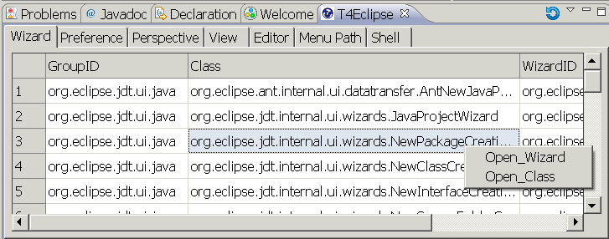
T4Eclipse User Guide ----- main view
T4Eclipse Main View
  T4Eclipse main view show all eclipse Wizard, Preference, Perspective, View and Editor extension information.
  The Menu Path Tab show all available main menu path in current page.
  The Shell tab can be used to listen all opened dialog
  the “Refresh All Data” view action will update all data in this view

Slide 11
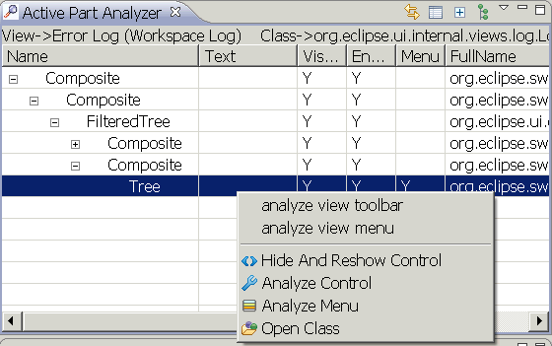
T4Eclipse User Guide ----- active part analyzer
Active part analyzer view
  The active part shows the control hierarchy and implementation class for the active part in eclipse page before click menu or toolbar item
  for analyzed view, user can continue analyze view toolbar and menu actions by click related popup menu, result will be show in “menu analyzer view ” and “toolbar analyzer view”
  popup menus in the active part can also be analyzed by check menu of the related control
    Important to know:
    Most menus are lazily created, show menu/submenu before analyze them

Slide 12
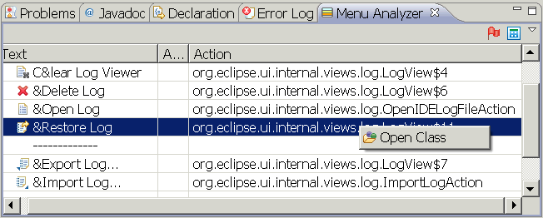
T4Eclipse User Guide ----- menu analyzer view
Menu analyzer view
  This view show analyzed menu item actions
  The toggle action will analyzed next showed menu once pressed
  The analyze eclipse main menu action will analyze all eclipse main menu in current page
    Show the menu first before analyze them
    Currently, the tool can not analyze all main menu items but some of them

Slide 13
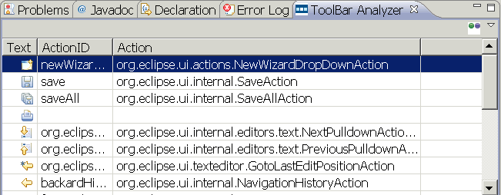
T4Eclipse User Guide ----- toolbar analyzer view
toolbar analyzer view
  This view show analyzed toolbar item actions
  The “analyze eclipse main toolbar” view action will analyze the main toolbar in current eclipse page.

Slide 14
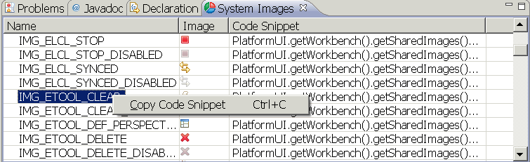
T4Eclipse User Guide ----- system image view
System image view
  This view show eclipse shared images
  Use the popup menu “Copy Code snippet” to copy the java code snippet and paste into java program

Slide 15
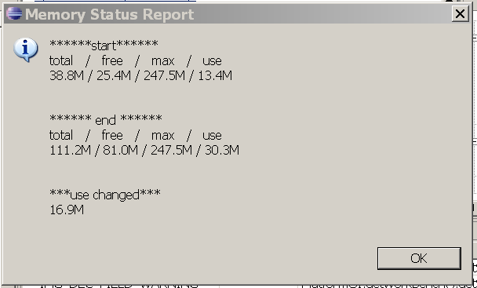
T4Eclipse User Guide ----- simple memory checker
Click the “T4Eclipse→miscellaneous→check memory change” to start track memory change
Do anything in eclipse….
Click “T4Eclipse→miscellaneous→check memory change” again , a dialog will show memory changes

Slide 16
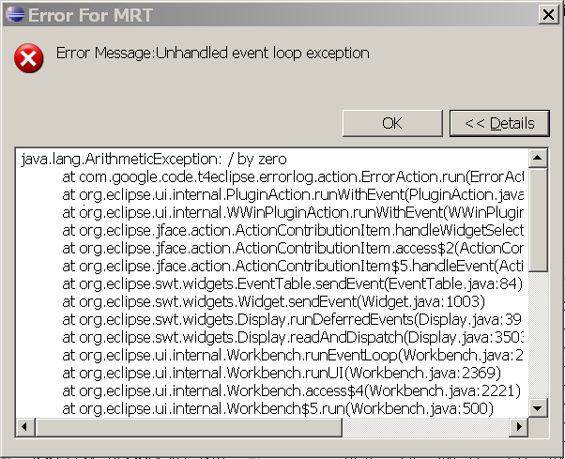
T4Eclipse User Guide ----- block error action
“block error” action is used to block eclipse runtime error will a model dialog once an error happens, it is used mainly when you manually testing newly created plug-ins.
after click “T4Eclipse→ miscellaneous→ Block Error” toggle action, t4eclipse will block any runtime error. If any error happens, the following like model dialog will show for the error.
The “T4Eclipse→ miscellaneous→ Run Error”
action is used to created an runtime error to check
Whether the above function works

Slide 17
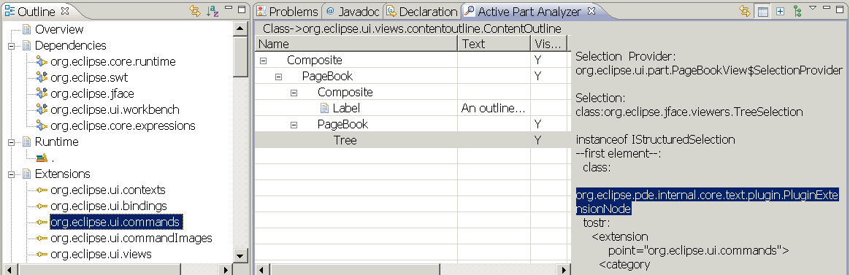
Answers for page 2
The above “active part view” show view implementation class, controls in this view and detail selection information the outline view on page2.

Slide 18

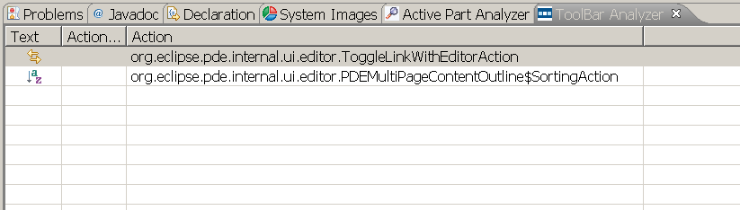
Answers for page 2
The above “Toolbar Analyzer” show outline view’s view action on page2

Slide 19
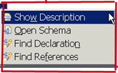
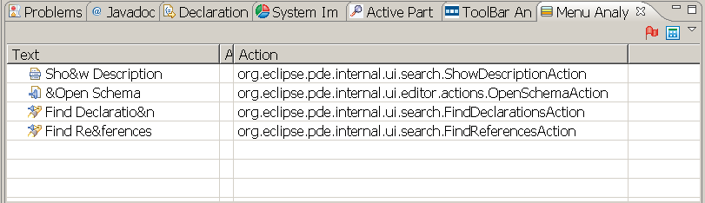
Answers for page 2
The above “Menu Analyzer view” show the popup menu actions on page2

Slide 20
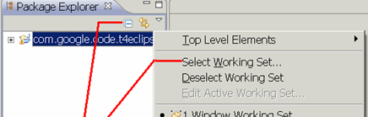
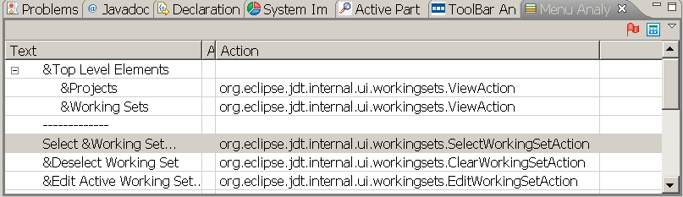
Answers for page 3
The above “Menu Analyzer view” show the view menu action on page3

Slide 21

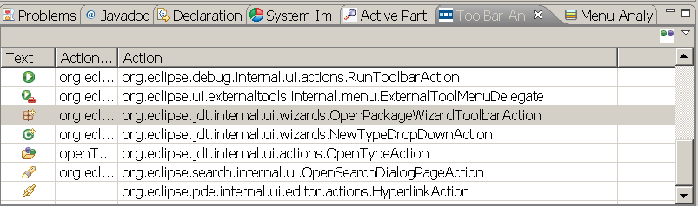
Answers for page 3
The above “Toolbar Analyzer view” show the main toolbar action on page3

Slide 22
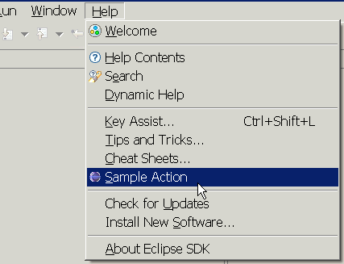
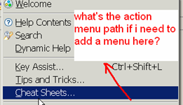
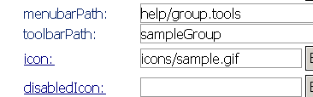
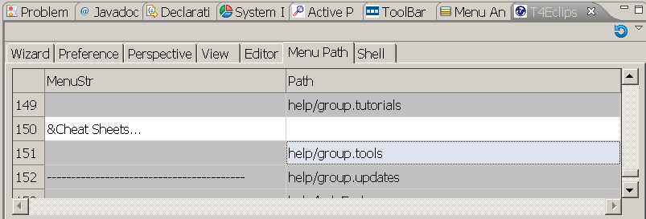
Answers for page 3
Get the needed action menu path easily using t4eclipse menu path tool

Slide 23
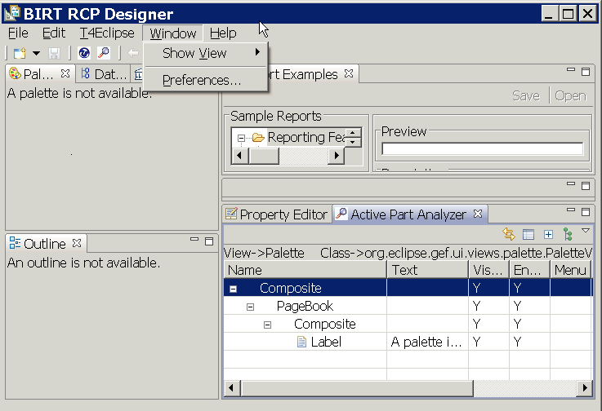
T4Eclipse works almost in all eclipse/rcp applications !
T4Eclispe used in Birt RCP application, the eclipse “plug-in spy tool” can not be used in such application because it’s dependency on PDE. But T4Eclipse works as it only depends on only two very basic plug-ins!

